Slide 1

A PROJECT PRESENTATION ON
STOCK MARKET FORCASTING & PREDICTION
MINDTREE.Ltd

Slide 2
Project No:- P132
Group No:- 01
Group Members
1. Hrutuja Mohangekar
2. Monika Sonawane
3. Gauri Agharkar
4. Roshni Katar
5. Shweta shriwastava
6. Vivek Taral
7. Harshvardhan Murkute

Slide 3
Objective
Data science approach to stock forcasting and prediction of MINDTREE Ltd. stock using Long Short-Term Memory (LSTM) model.
Introduction
Stock market prediction is the act of trying to determine the future value of company stock or other financial instruments traded on an exchange. The successful prediction of a stock’s future price could yield a significant profit. In this application, we used the LSTM network to predict the next 10 days closing stock price using the past 10 years stock prices. Used pandas,numpy,matplotlib,plotly,datetime to get stock information, visualize different aspects of it.

Slide 4
Project Architecture / Project Flow
Collection of dataset
Business understanding
Initial Analysis (EDA) , feature engineering
Model building
Model deployment
Model deployment

Slide 5
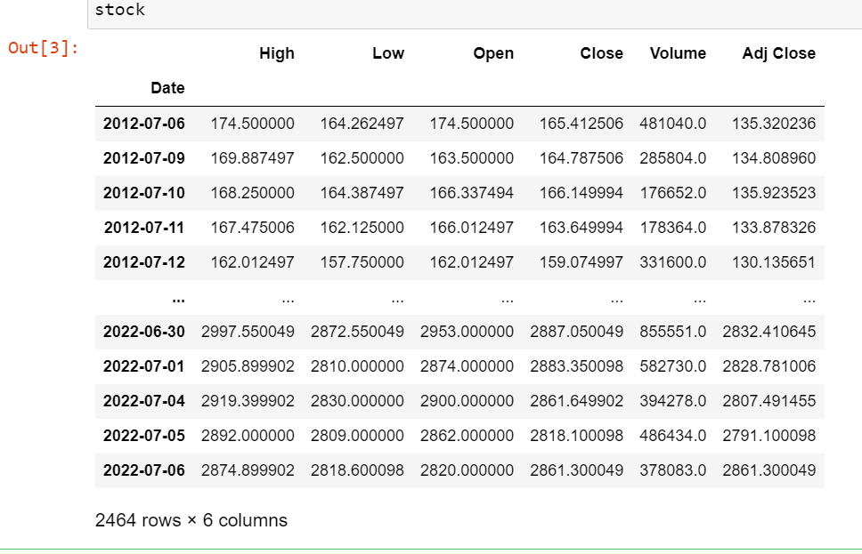
Dataset Source
We are extracting data from yfinace.com for the past 10 years for stock prediction.
We have taken 2012 to 2022 years data set.
Dataset of stock
Import the dataset
stock = pdr.get_data_yahoo('MINDTREE.NS',
start=datetime.datetime(2012, 7, 6),
end=datetime.datetime(2022, 7, 6))
stock

Slide 6
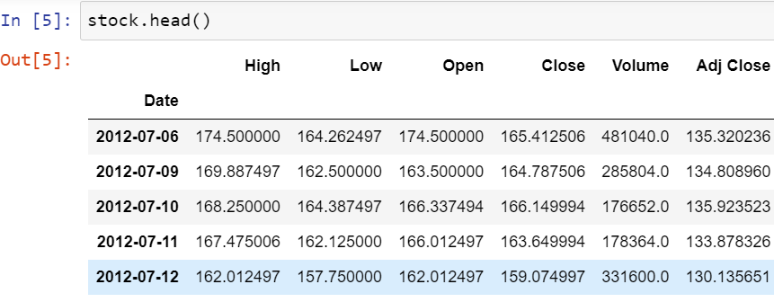
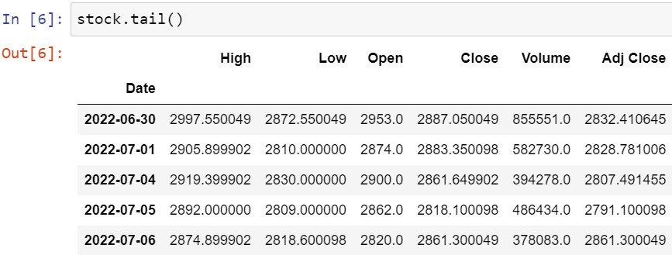
Description of each attribute
Date:- Trading date of the stock.
Open:- Stock’s opening price
High:- Highest price of the stock on a particular trading day.
Low:- Lowest stock price during trade day.
Close:- Closing price of the stock during trade-in particular day.
Volume:- This is the number of stocks traded on a particular day.
Adj Close:- This is the ending or closing price of the stock which was changed to contain any corporations’ actions and distribution that is occurred during trade time of the day.
Exploratory Data Analysis (EDA)

Slide 7
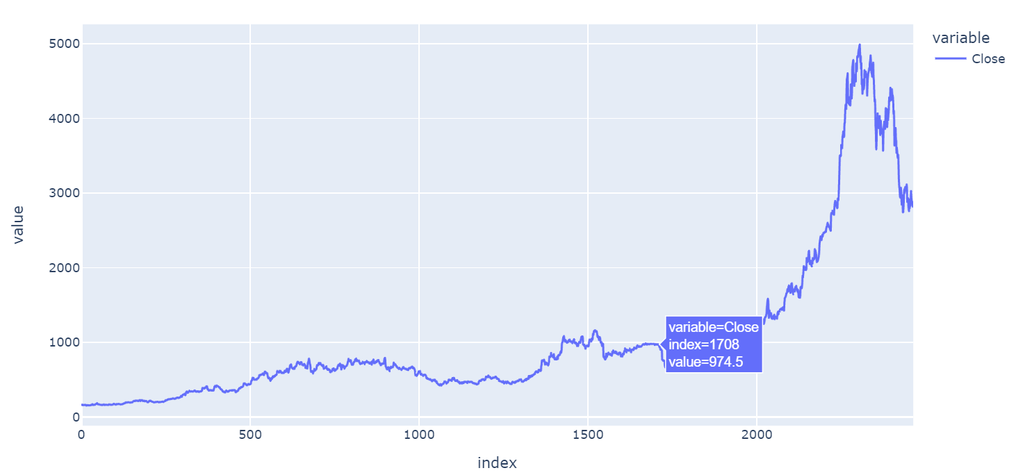
Using plotly library we have taken (Close) column for time Series
import plotly.express as px
fig2 = px.line(stock.Close)
fig2.show()
Visualizing of stock dataset

Slide 8
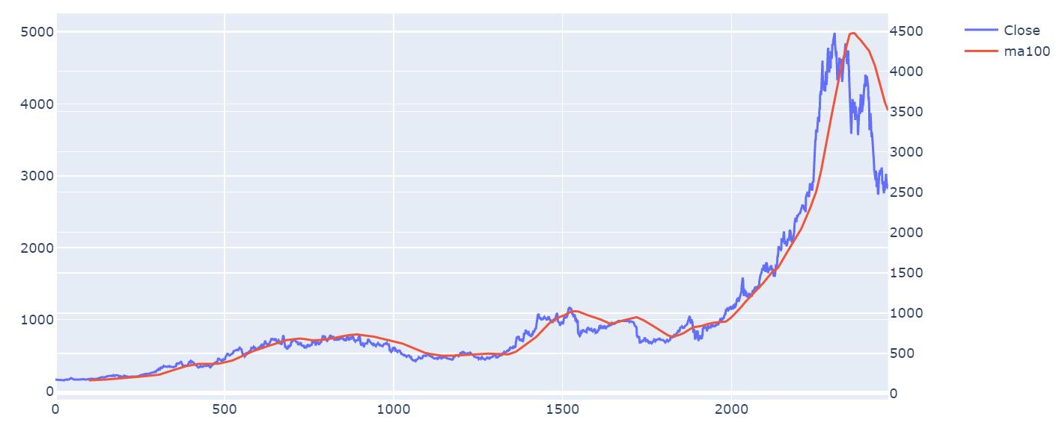
Using (close) column we have plotted moving average of 100 days
Visualizing of stock dataset

Slide 9
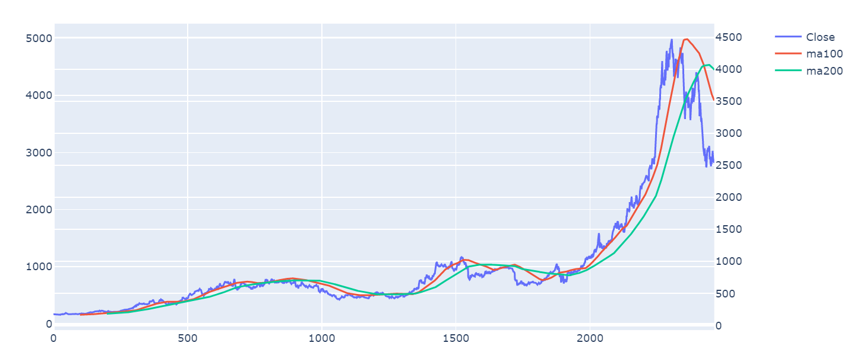
Using (close) column we have plotted moving average of 100 & 200 days
Visualizing of stock dataset
Remark:- When green line crosses red line sudden downfall & upfall happens and it has observed in above plot

Slide 10
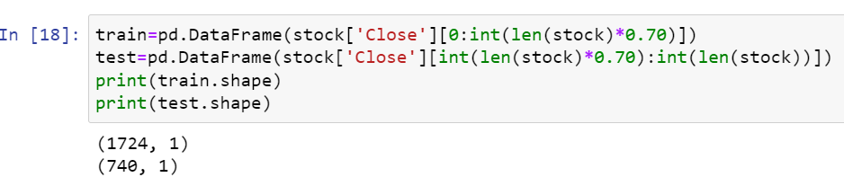
We have created a new dataframe
we have split (Close) column into Train & Test data
Train data
Test data
We have created a new dataframe into Train &test , Then we have split close column.we have take 10 years data in close column so we predict that single day value and next 10 days prediction value.

Slide 11
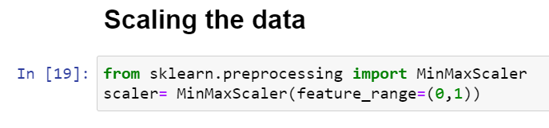
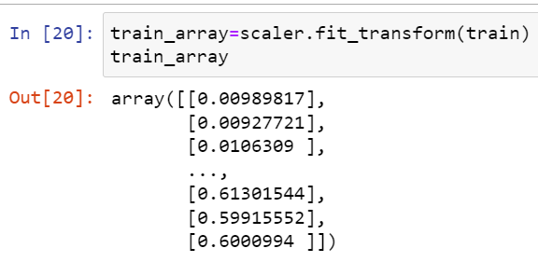
Scaling the data
We have scaled the data using MinMaxScaler library ,the scaler range is 0 to 1.
Transform the data

Slide 12
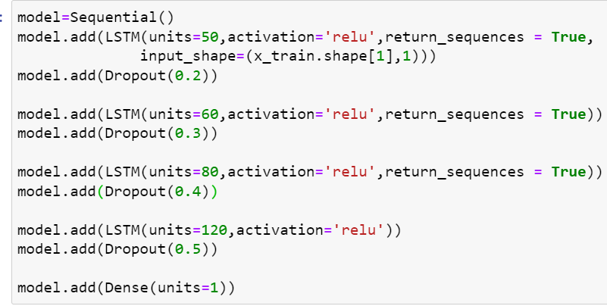
Building the LSTM
In order to build the LSTM, we need to import a couple of modules from Keras
1. Sequential for initializing the neural network
2. Dense for adding a densely connected neural network layer
3. LSTM for adding the Long Short-Term Memory layer
4. Dropout for adding dropout layers that prevent overfitting
When defining the Dropout layers, we specify 0.2, meaning that 20% of the layers will be dropped.
Thereafter, we add the Dense layer that specifies the output of 1 unit.
Now, it’s time to build the model. We will build the LSTM with different sets of neurons and 3 hidden layers. Finally, we will assign 1 neuron in the output layer for predicting the normalized stock price. We will use the MSE loss function and the Adam optimizer.

Slide 13
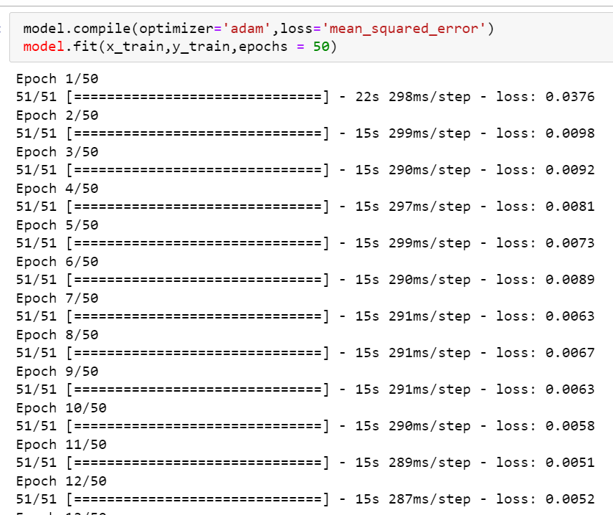
After this, we compile our model using the adam optimizer and set the loss as the mean_squarred_error.
This will compute the mean of the squared errors.
Next, we will fit the model to run on 50 epochs

Slide 14
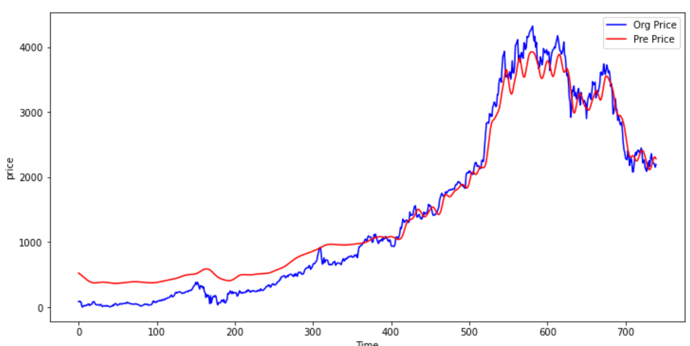
Graph of y_test data

Slide 15
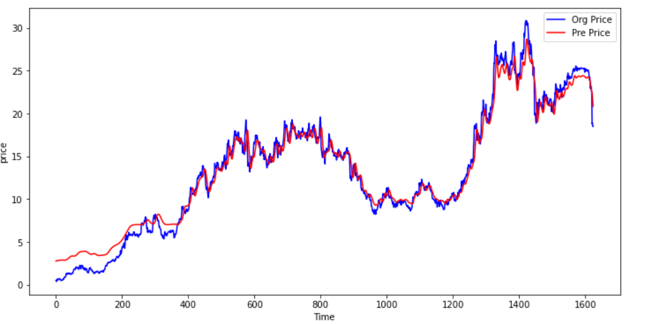
Graph of y_train data

Slide 16
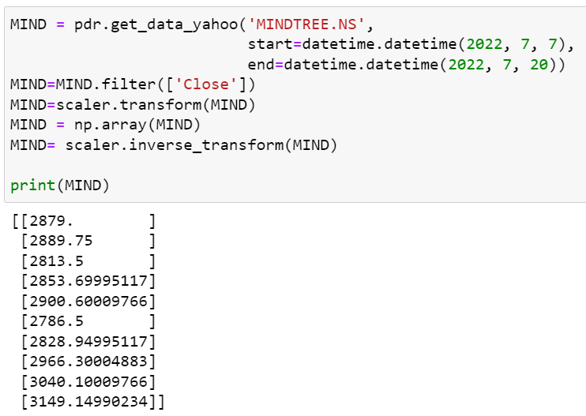
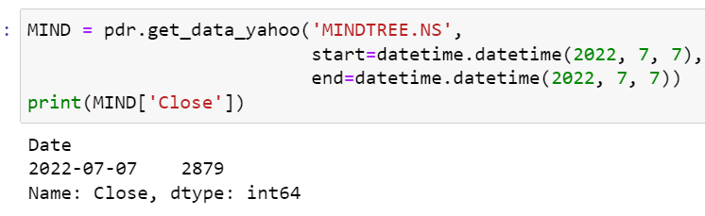
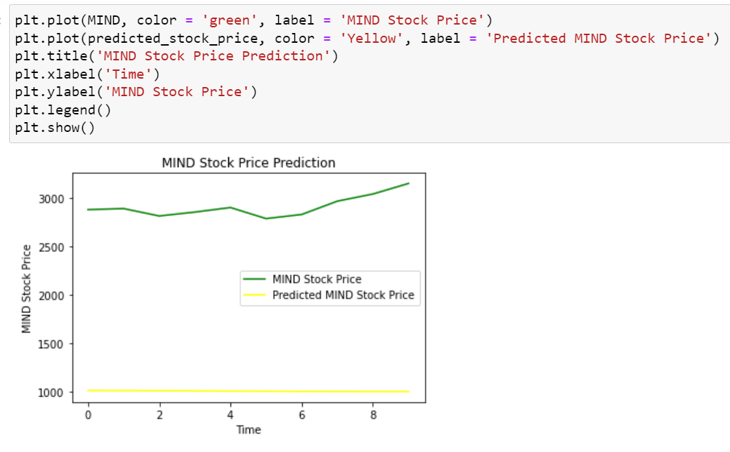
Predictions for Next Single Day
Predictions for Next 10 Day
Mind Stock Price prediction

Slide 17
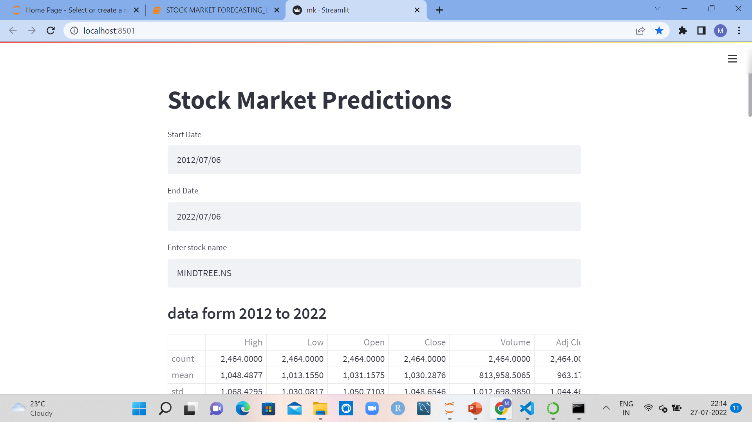
Model Deployment on Web Server
For model deployment ,we have implemented data on streamlit.
1.Create .py file for streamlit containing all visualization tasks (Import dataset,Name of Stock, Describe
& Plots/Graphs)
2.Open the command prompt
3.Run pip install streamlit
streamlit run filename.py
4.New window will open containing streamlit data.

Slide 18
Conclusion
Determining the stock market forcast is always been challenging work for business analyst.the project applies data mining technology of neural network stock price forcast and receives a preferable result
THANK YOU

